Slide 1
Reading Electrical Schematics
These basic tutorials start with electrical symbols and schematic design and proceed to include the specific schematics for the production machines you use in your plant. They are designed to help you use an electrical schematic to work your way through any problem that may occur during the manufacturing process.
Being able to read and understand an electrical schematic is the fastest
way to solve an electrical problem. We suggest that you start with the tutorial named What is an Electrical Schematic, to help you understand what some of the electrical symbols represent and how the electrical schematics work. The tutorials will run automatically in Windows® Media Player.
You can pause, go forward, or go backward during the presentation. When finished, just close Media Player. Each module takes about ½ hour to complete.
It would be helpful to have your RoofTracker™ press electrical schematic
from the Maintenance Manual to follow along.
START
RoofTracker
Schematic Training

Slide 2
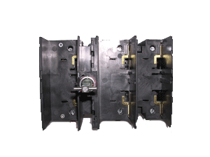

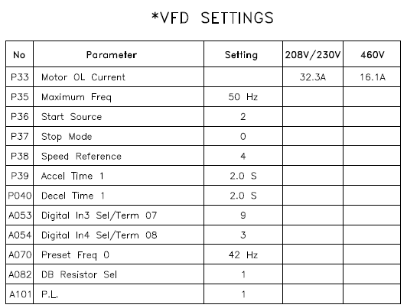
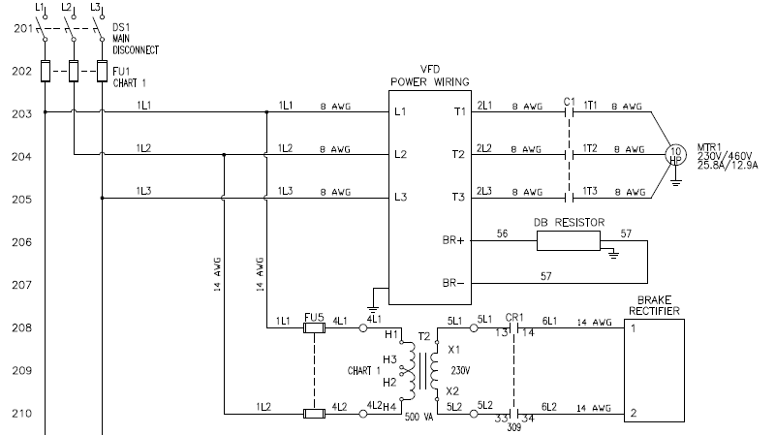
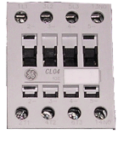
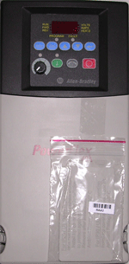
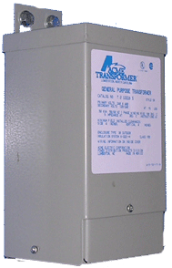

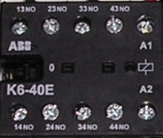
Reading Electrical Schematics

Slide 3
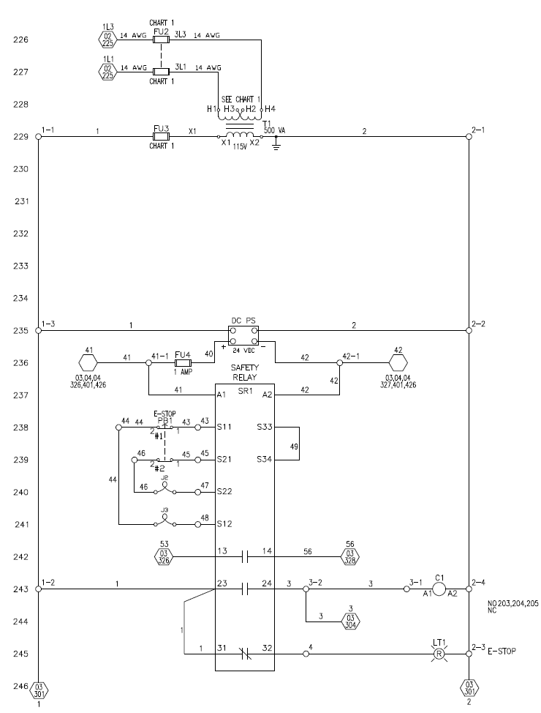
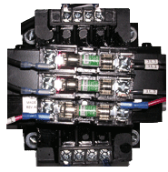
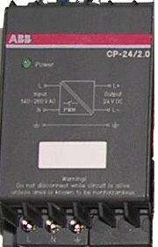

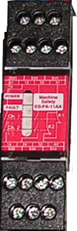

Reading Electrical Schematics

Slide 4
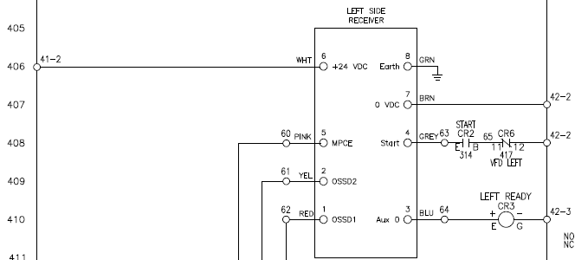
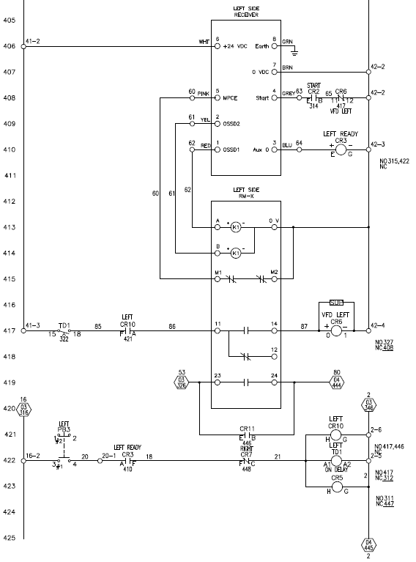







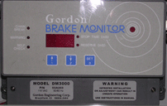
Reading Electrical Schematics

Slide 5


Reading Electrical Schematics

Slide 6




Reading Electrical Schematics

