Slide 1
Navigating the Quick Reference Parts Guide
Main Menu
The next screen is the Main Menu, which has buttons to reach each category that this parts guide uses.
Each category may be further divided into different sections, each with their own button on the category’s main screen.
From each screen, you can:
Return to the Main Menu
Return to the category’s main page
Go forward or backward one screen at a time within the category
Click a link to order the part on-line or via e-mail
In addition to using the buttons provided, you can manually scroll through the screens by clicking your left mouse button.
Exit
How to get
To the
eStore
www.mii.com
To access a different program or file while leaving the Quick Reference Parts Guide open, hold the Alt button while pressing the Tab button on your keyboard.
mitekparts@mii.com

Slide 2
How to Get to the eStore™
Example
Once you find the part number you need, click on the Web site link.
www.mii.com
mitekparts@mii.com

Slide 3
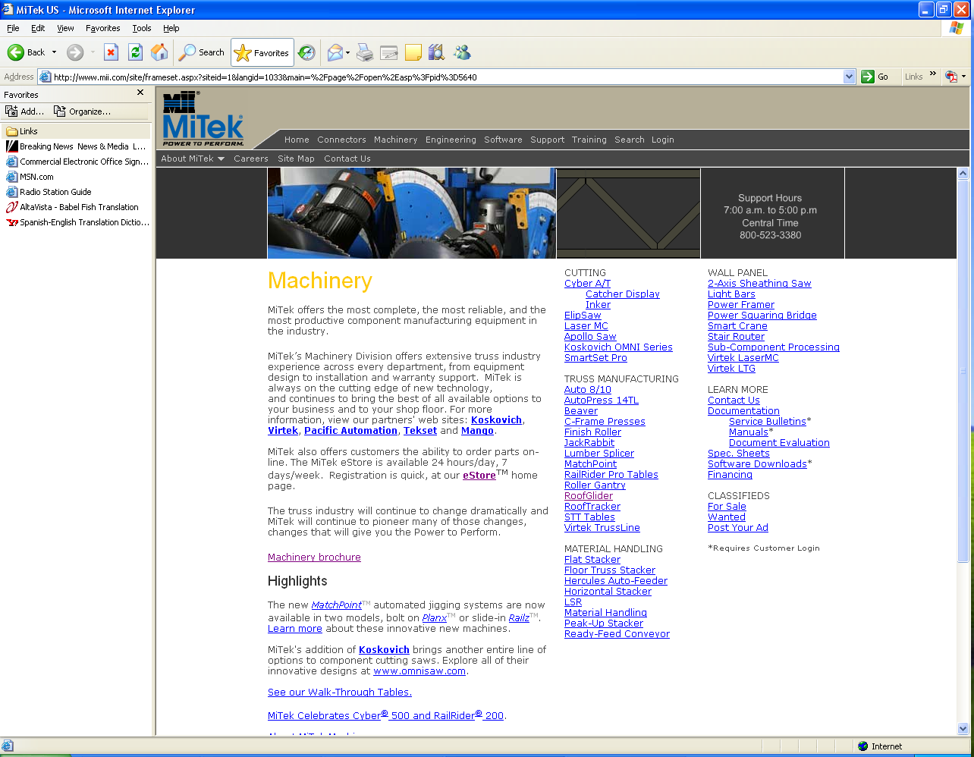
How to Get to the eStore
www.mii.com
This is the Web site. Click on the Machinery menu.
mitekparts@mii.com

Slide 4
How to Get to the eStore
www.mii.com
mitekparts@mii.com
Click the Ordering Parts menu, then, click eStore.

Slide 5
How to Get to the eStore
Main Menu
Exit
www.mii.com
Enter your eStore login and password and click Login.
If you need to register, click the Click here to register button.
mitekparts@mii.com

Slide 6
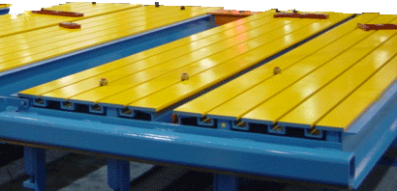
Jigging
Tekset Jigging
Standard Fixture
Parts
Laser Fixture
Parts
MiTek Standard
Fixture Parts
Robbins Jigging
1
2
Click on the one of the links to the right to order your parts from our on-line eStore or via e-mail.
Exit
www.mii.com
E-mail:mitekparts@mii.com

Slide 7
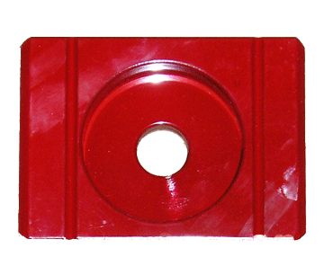
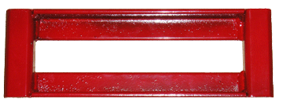
Standard Fixture Parts
Main Menu
Standard fixture plate part# 010111
Exit
Standard straight stop 12” part# 010112
Standard straight stop 18” part# 010113
Standard straight stop 24” part# 010114
www.mii.com
mitekparts@mii.com

Slide 8
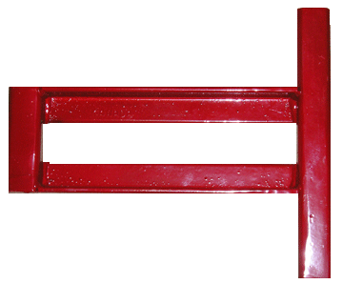
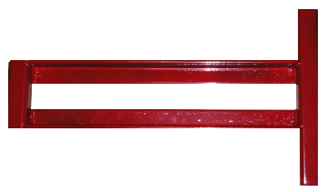
Standard Fixture Parts
Main Menu
Standard heel stop part# 010115
No photo
Standard short heel stop part# 010117
Exit
Standard T stop 12” part# 010119
Standard T stop 18” part# 010120
www.mii.com
mitekparts@mii.com

Slide 9
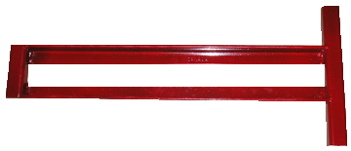
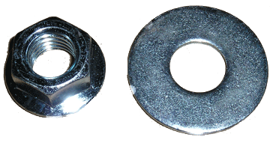
Standard Fixture Parts
Main Menu
Standard T stop 24” part# 010121
Exit
Rotary T-bolt with flange nut part# 010126
Flange nut and washer part# 010127
Special modified wrench part# 010105
www.mii.com
mitekparts@mii.com

Slide 10
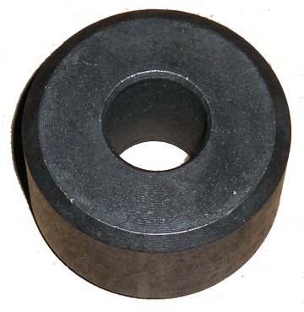
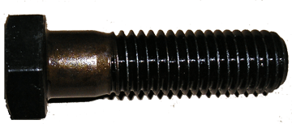
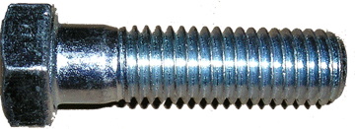
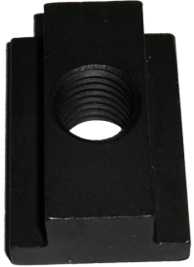
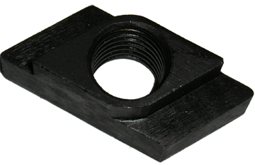
Standard Fixture Parts
Main Menu
Puck 1 ¾” part# 010101
Exit
Standard bolt Qty. per kit 120 part# 010160
Single bolt part# 327471
www.mii.com
mitekparts@mii.com
Rotary T nut part# 010104
Standard T nut part# 010103

Slide 11
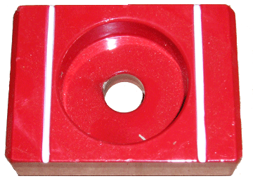
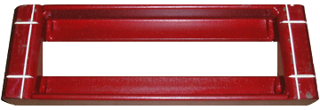
Laser Fixture Parts
Main Menu
Target plate LA part# 010131
Exit
Straight stop 12” LA part# 010132
Straight stop 18” LA part# 010133
Straight stop 24” LA part# 010134
www.mii.com
mitekparts@mii.com
Heel stop LA part# 010135

Slide 12
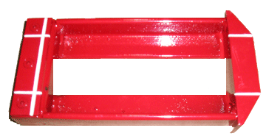
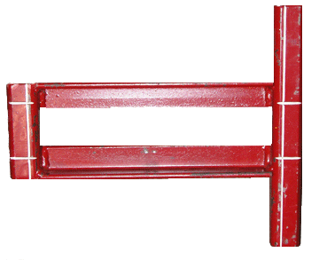
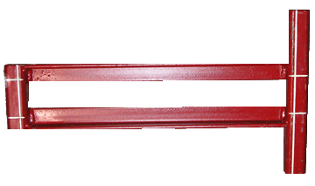
Laser Fixture Parts
Main Menu
Short heel stop LA part# 010137
Exit
T stop LA 12” part# 010139
T stop LA 18” part# 010140
www.mii.com
T stop LA 24” part# 010141
mitekparts@mii.com

Slide 13
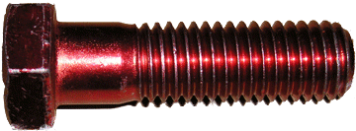
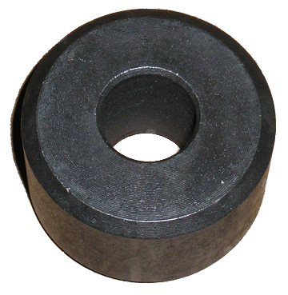
Laser Fixture Parts
Main Menu
Laser bolt Qty. per kit 120 part# 010150
Rotary T-bolt with flange nut part# 010126
Exit
Single Laser bolt part# 010151
Flange nut and washer part# 010127
Puck 1 ¾” part# 010101
Special modified wrench part# 010105
www.mii.com
mitekparts@mii.com
Rotary T nut part# 010104
Standard T nut part# 010103

Slide 14
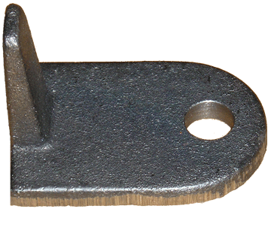
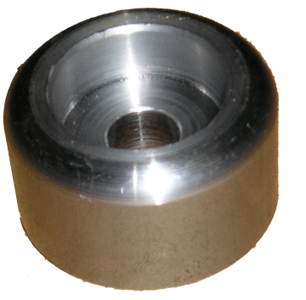
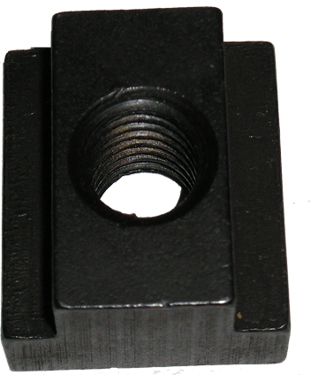
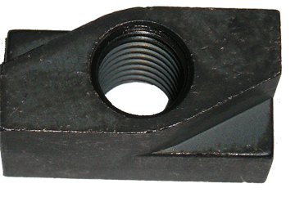
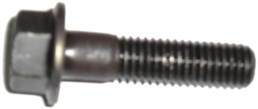
MiTek Standard Jigging
Locating slide part# 87303-102
Main Menu
Exit
T nut part# 201038
Jigging cog part# 87301
¼ turn nut part# 201037
Flange bolt part# 310947
www.mii.com
mitekparts@mii.com

Slide 15
Robbins Jigging
Main Menu
Peak assembly female part# 006-TAB-0028
Exit
Peak assembly male part# 006-TAB-0031
Left heel bar part# 006-TAB-0025
www.mii.com
Right heel bar part# 006-TAB-0026
mitekparts@mii.com

Slide 16
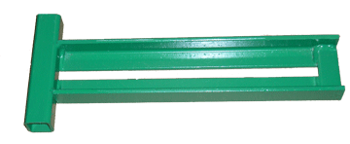
Robbins Jigging
Main Menu
Bottom chord bar part# 006-TAB-0024
Exit
Short tee bar part# 006-TAB-0027
Long tee bar part# 006-TAB-0083
www.mii.com
mitekparts@mii.com

Slide 17
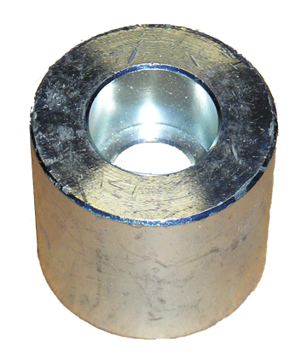
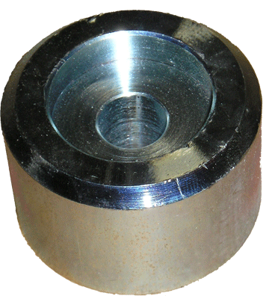
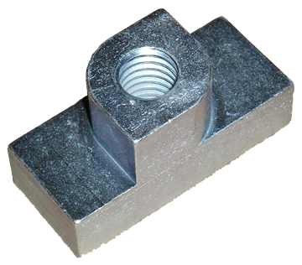
Robbins Jigging
Main Menu
Puck part# 30076
Exit
Puck laser 2” part# 006-TAB-3040
www.mii.com
¼ Turn tee nut part# 006-TAB-0009
mitekparts@mii.com

Slide 18
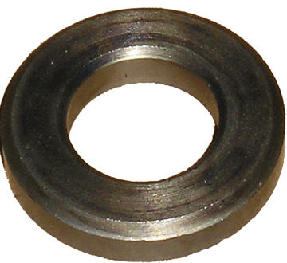
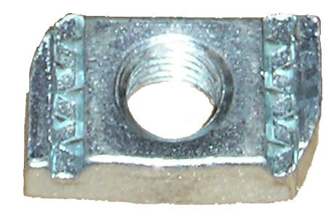
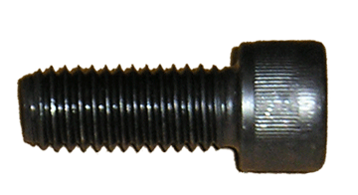
Robbins Jigging
Main Menu
½” Wrought washer part# 006-FAS-0165
Exit
Unistrut nut part# 200010
Socket head cap screw 1 ¼” part# 326363
www.mii.com
mitekparts@mii.com
Socket head cap screw 1 1/2” part# 326365

