Slide 1
Quick Reference Parts Guide Introduction
Choice Menu
This Quick Reference Parts Guide is an easy way to locate part numbers to common replacement parts. It does not include items such as wire or their cord grips, terminal blocks, or mounting brackets. It also does not include standard hardware like nuts and bolts. To locate parts that are not covered here, refer to the drawing set in your equipment manual, part number 001098 for servo Planx and part number 001091 for non servo Planx.
Navigating the
CD
Exit
www.mii.com
mitekparts@mii.com

Slide 2
Navigating the Quick Reference Parts Guide
Choice Menu
The next screen is the Main Menu, which has buttons to reach each category that this parts guide uses.
Each category may be further divided into different sections, each with their own button on the category’s main screen.
From each screen, you can:
Return to the Main Menu
Return to the category’s main page
Go forward or backward one screen at a time within the category
Click a link to order the part on-line or via e-mail
In addition to using the buttons provided, you can manually scroll through the screens by clicking your left mouse button.
Exit
How to get
To the
eStore
To access a different program or file while leaving the Quick Reference Parts Guide open, hold the Alt button while pressing the Tab button on your keyboard.
www.mii.com
mitekparts@mii.com

Slide 3
How to get to the eSTORE
Example
Once you find the part number you need, click on the web site link
www.mii.com
mitekparts@mii.com

Slide 4
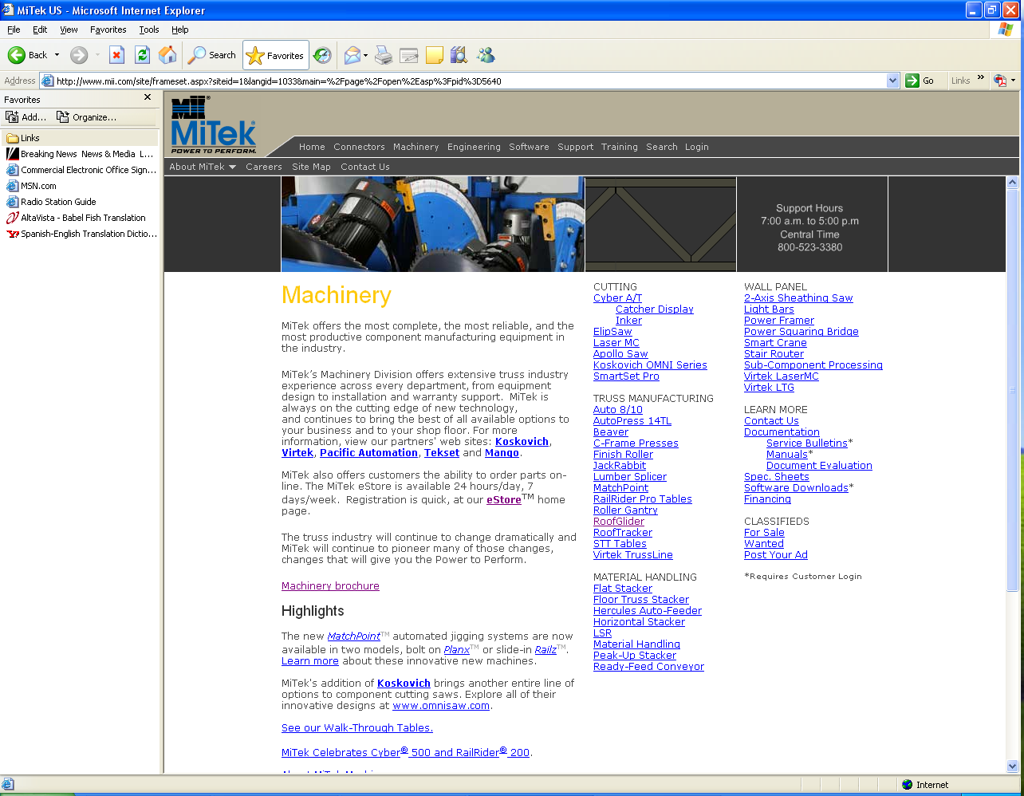
How to get to the eSTORE
www.mii.com
This is the web site, click on the machinery tab
mitekparts@mii.com

Slide 5
How to Get to the eStore
www.mii.com
mitekparts@mii.com
Click the Ordering Parts menu, then, click eStore.

Slide 6
How to Get to the eStore
Choice Menu
Exit
www.mii.com
Enter your eStore login and password and click Login.
If you need to register, click the Click here to register button.
mitekparts@mii.com

Slide 7
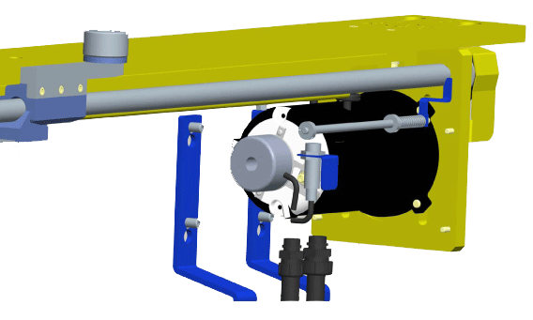
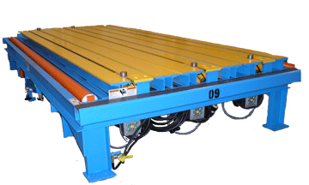
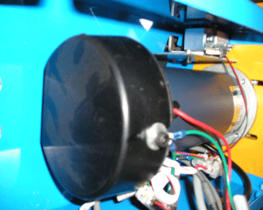
Planx
Choice Menu
Navigating the
CD
If you have this type of assembly
You have non servo click the non servo box
Non Servo
Exit
As of 01/23/2009
If you have this type of assembly
You have servo click the servo box
www.mii.com
Servo
mitekparts@mii.com

Slide 8
Planx
Non Servo
Mechanical Parts
Exit
Electrical Parts
Back To Choice Menu
www.mii.com
mitekparts@mii.com

Slide 9
Planx
Servo Main menu
Navigating the
CD
Mechanical Parts
Exit
Electrical Parts
Back To Choice Menu
www.mii.com
mitekparts@mii.com

Slide 10
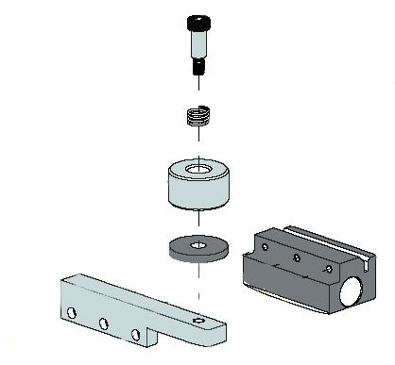
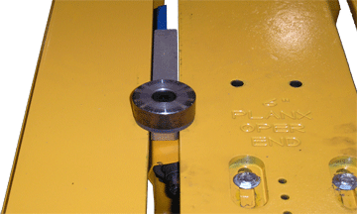
Mechanical Parts
Main Menu
Servo
Shoulder bolt Part# 328080
Australia Part numbers
Shoulder bolt part# 328092
Spring part# 370003
Puck part# 42152
Spring Part# 370001
Main Menu
Non Servo
Puck 2’ Part# 42107
Shoe or acme nut Part# 42003
Finger puck Part# 42108
Washer puck Part# 42045
Exit
www.mii.com
mitekparts@mii.com

Slide 11
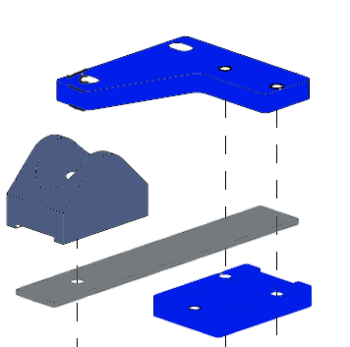
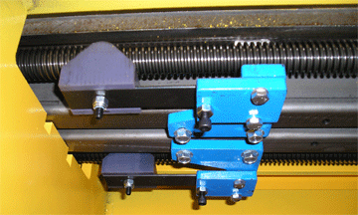
Mechanical Parts
Main Menu
Spring base Part# 42061
Guide block Part# 42058
Exit
Spring tongue Part# 42060
Spring clamp Part# 42059
Shaft Planx 166 ¾” Part# 42148
Shaft Planx 167 ½” Part# 42033
Shaft Planx 168” Part# 42033
Shaft Planx 144” Part# 42320
Shaft Planx 191 ½” Part# 42074
The above numbers are not shaft
length they are Planx length
www.mii.com
mitekparts@mii.com

Slide 12
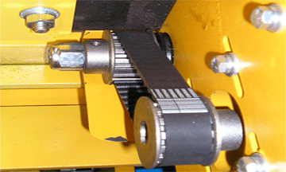
Mechanical Parts
Main Menu
Exit
Gearbelt pulley Part# 531076
Woodruff key Part# 531010
Timing belt 6” Planx Part# 531011
Timing belt 8” Planx Part# 531015
Timing belt 10” Planx Part# 531013
www.mii.com
Gearbelt pulley Part# 531077
mitekparts@mii.com
Locknut Part# 361997

Slide 13
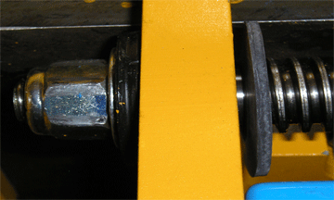
Mechanical Parts
Main Menu
Bearing Part# 419010
Exit
Seal Part# 414012
Rubber washer Part# 446116
www.mii.com
mitekparts@mii.com

Slide 14
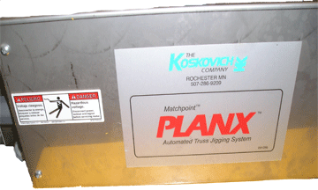
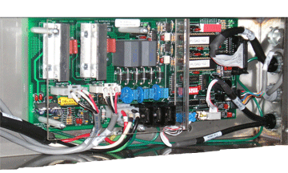
Electrical Parts
Servo 240 volts
Main Menu
Cover Part# 42201
Cover
Exit
Under the cover
Control card Part# 92230
Cable assembly Part# 508786
Cable assembly Part# 508795
Cable assembly Part# 508781
www.mii.com
mitekparts@mii.com
Shield Part# 42219
Cable assembly Part# 508778
Cable assembly external power Part# 508780

Slide 15
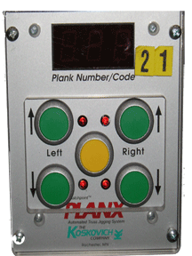
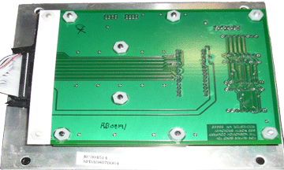
Electrical Parts
Servo 240 volts
Main Menu
Plexi shield Part# 42076
Exit
Spda display card Part# 194633
www.mii.com
mitekparts@mii.com

Slide 16
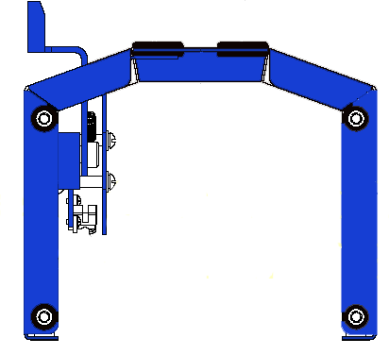
Electrical Parts
Servo 240 volts
Main Menu
Rubber grommet Part# 443913
Includes flag assembly and rubber grommet
6” ASM top assembly Part# 42221-501
8” ASM top assembly Part# 42224-501
10” ASM top assembly Part# 42225-501
Exit
Cover only Part# 42222-501
www.mii.com
6” flag assembly only Part# 42260-501
8” flag assembly only Part# 42267-501
10” flag assembly only Part# 42265-501
mitekparts@mii.com

Slide 17
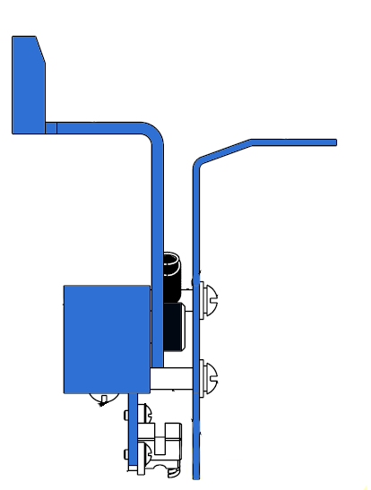
Electrical Parts
Servo 240 volts
Main Menu
Flag shoe
6” Part# 42215
8” Part# 42216
10” Part# 42217
Flag plate
All Part# 42261
Exit
Spring Part# 371125
Shoulder bolt Part# 328251
Flag block
All Part# 42262
www.mii.com
Flag bracket
All Part# 42263
mitekparts@mii.com
Flag sensor Part# 508787

Slide 18
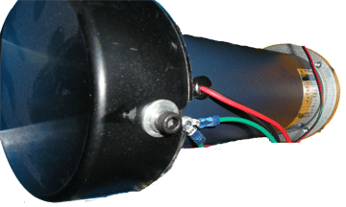
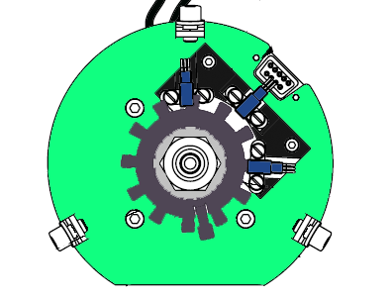
Electrical Parts
Servo 240 volts
Main Menu
Cover Part# 42205
Motor Part# 474207
Under the cover
Exit
Hall effect sensor assembly Part# 42203-501
Flag disk Part# 42207
Collar Part# 42209
Locknut Part# 361987
www.mii.com
mitekparts@mii.com
Part# 42210-501 includes motor, complete hall effect sensor and timing gear.

Slide 19
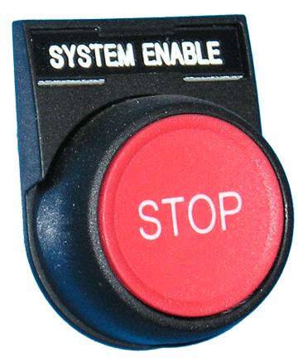
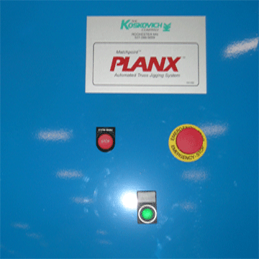
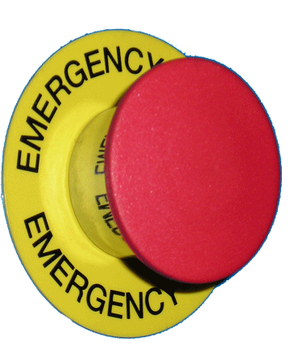
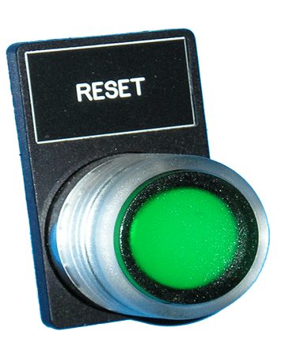
Electrical Parts
Servo 240 volts
Main Menu
Name plate Part# 513973
Oper PB Part# 513607
Cap engraved Part# 513608
Contact block Part# 513739
Exit
Name plate Part# 513829
Oper. PB Mshrm Part# 513656
Contact block Part# 513650 Qty needed 2
Name plate Part# 513748
www.mii.com
Name plate holder Part# 513676
mitekparts@mii.com
Oper. PB Part# 513781
Light Part# 513606
Contact block Part# 513650 Qty needed 1

Slide 20
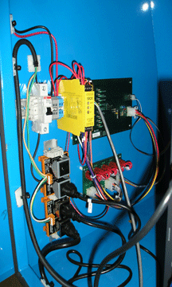
Electrical Parts
Servo 240 volts
Main Menu
Circuit breaker Part# 516380
Safety relay Part# 519709
SPC Card Part# 194634
Exit
SPSU Card Part# 194636
Receptacle duplex Part# 511589
www.mii.com
mitekparts@mii.com

Slide 21
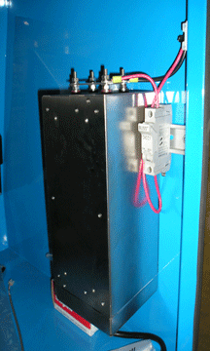
Electrical Parts
Servo 240 volts
Main Menu
Exit
Fuse holder Part# 516349
Fuse Part# 516396
Power supply Part# 519779
www.mii.com
mitekparts@mii.com

Slide 22
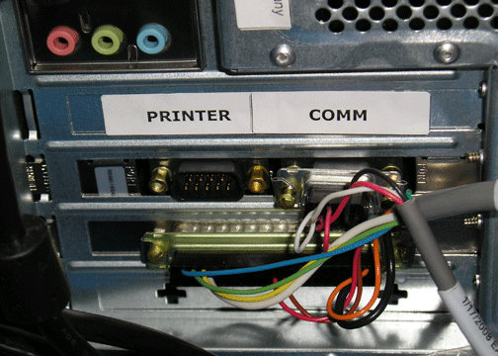
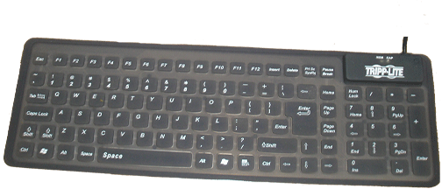
Electrical Parts
Servo 240 volts
Main Menu
XP Computer Part# 504692
Exit
Flex keyboard Part# 504567
www.mii.com
mitekparts@mii.com
Monitor Not Shown
17” Flat monitor Part# 504564

Slide 23
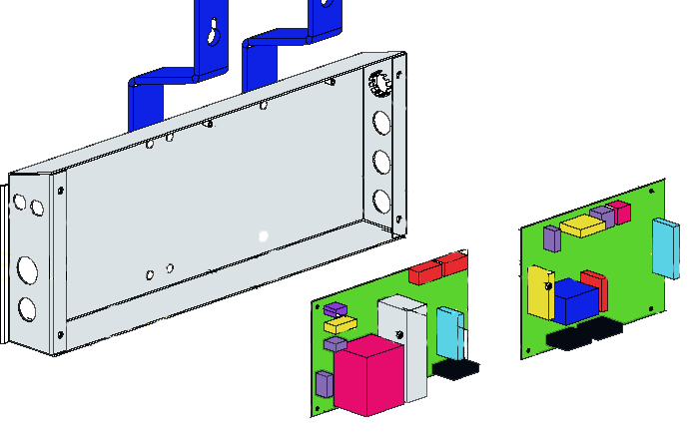
Electrical Parts
Non Servo 240 volts
Main Menu
Cover part# 42068
Cover
Exit
Under the cover
Control card Part# 194612
www.mii.com
mitekparts@mii.com
JSM2 motor driver card Part# 194610

Slide 24
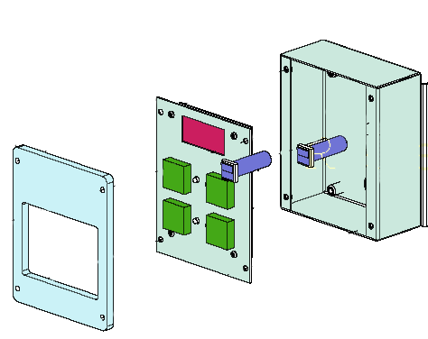
Electrical Parts
Non Servo 240 volts
Main Menu
Exit
Circuit breaker Part# 194611
JPDA display card Part# 194609
www.mii.com
mitekparts@mii.com
Plexi shield Part# 42076

Slide 25
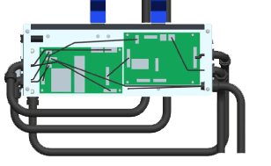
Electrical Parts
Non Servo 240 volts
Main Menu
Cable assembly Part# 508767
Cable assembly Part# 508763
Cable assembly Part# 508773
Exit
Cable assembly Part# 508766
Cable assembly Part# 508762
www.mii.com
Cable assembly Part# 508769
mitekparts@mii.com
Cable assemble Part# 508768

Slide 26
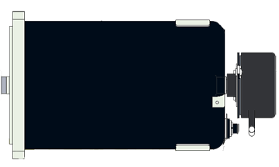
Electrical Parts
Non Servo 240 volts
Main Menu
Motor Part# 474206
Exit
Cable assembly Encoder Part# 508760
Cable assembly prox Part# 508761
www.mii.com
mitekparts@mii.com

Slide 27
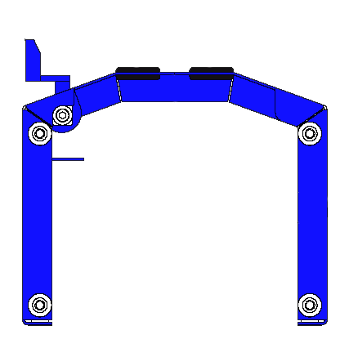
Electrical Parts
Non Servo 240 volts
Main Menu
Rubber grommet Part# 443913
Includes flag assembly and rubber grommet
6” ASM top assembly Part# 42126-501
8” ASM top assembly Part# 42120-501
10” ASM top assembly Part# 42098-501
Exit
Cover only Part# 42025-501
www.mii.com
mitekparts@mii.com

Slide 28
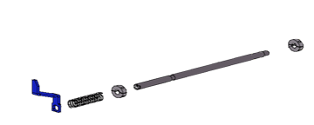
Electrical Parts
Non Servo 240 volts
Main Menu
Exit
Guide rod Part# 42029
Spring Part# 370056
Collar Part# 541001
6” shoe flag Part# 42013
8” shoe flag Part# 42095
10” shoe flag Part# 42087
www.mii.com
mitekparts@mii.com

Slide 29
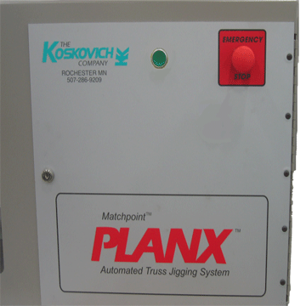
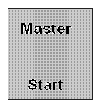
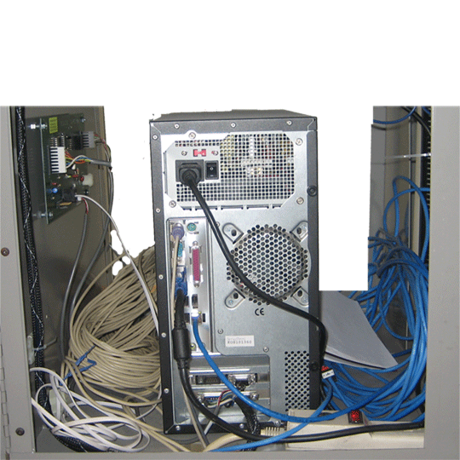
Electrical Parts
Non Servo 240 volts
Main Menu
Oper PB Part# 513641
Contact block Part# 513649
Exit
Keyboard flex Part# 504567
Oper PB Part# 513642
Contact block part# 513650
Console interface card Part# 194600
Computer Part# 504692
www.mii.com
Rmote Mntr conn card Part# 194613
mitekparts@mii.com
Monitor not shown Part# 504564

